Slide 1
Principles of Single-Cell Bioinformatics
INTRODUCTION TO SINGLE-CELL SEQUENCING AND COMPUTATIONAL ANALYSIS
2021 - Symposium
Notes:
1

Slide 2
Overview
Single-Cell bioinformatics: why?
NGS bioinformatics concepts and terminology
Single-cell RNASeq bioinformatics pipelines
How to start

Slide 3

Single-cell RNA Data Analysis: Why?
Without bioinformatics analysis sequencing data is meaningless

Slide 4
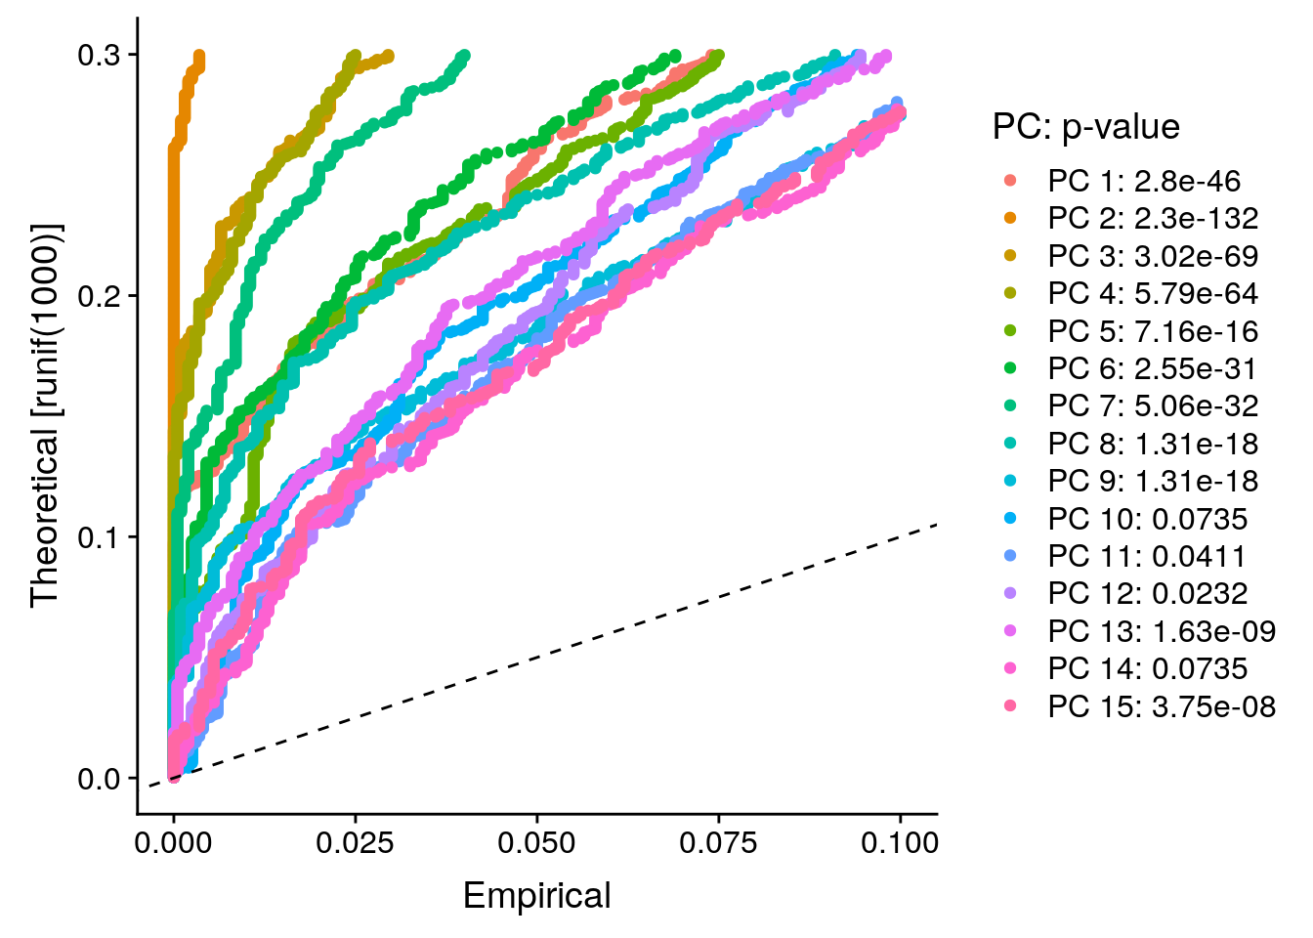
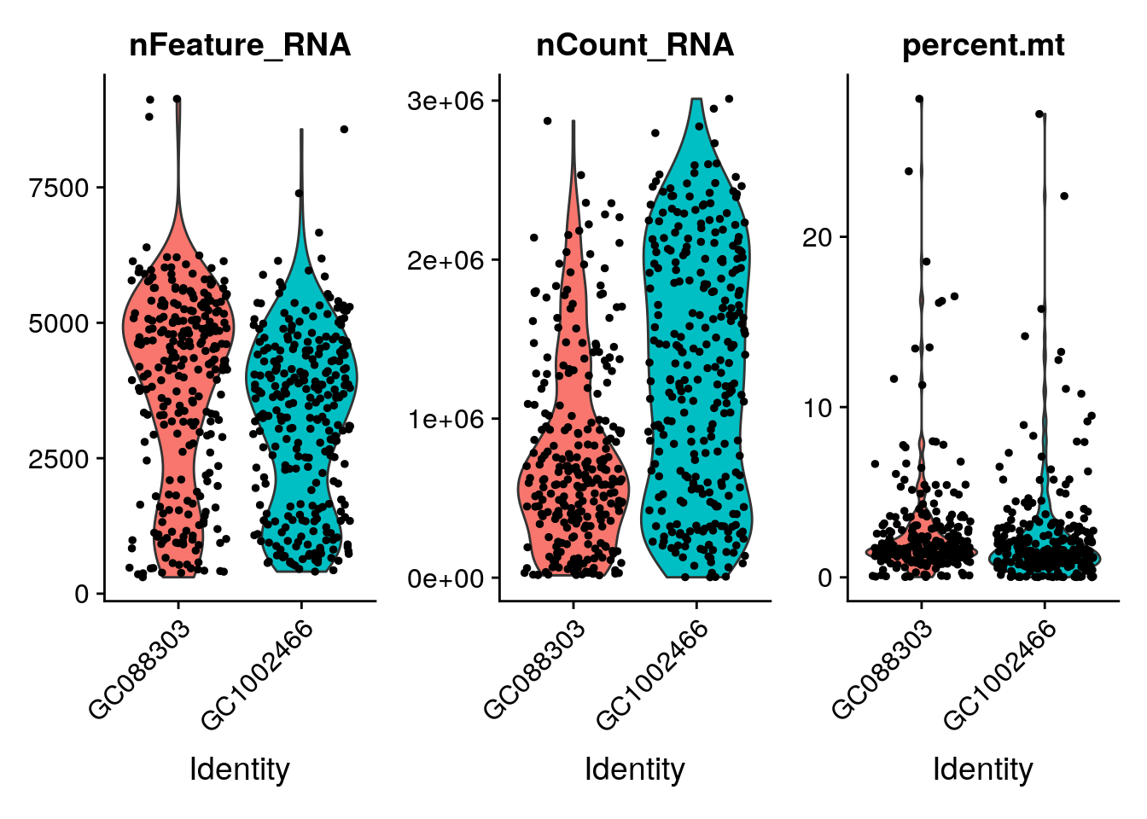
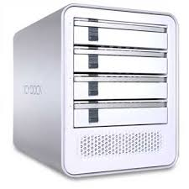
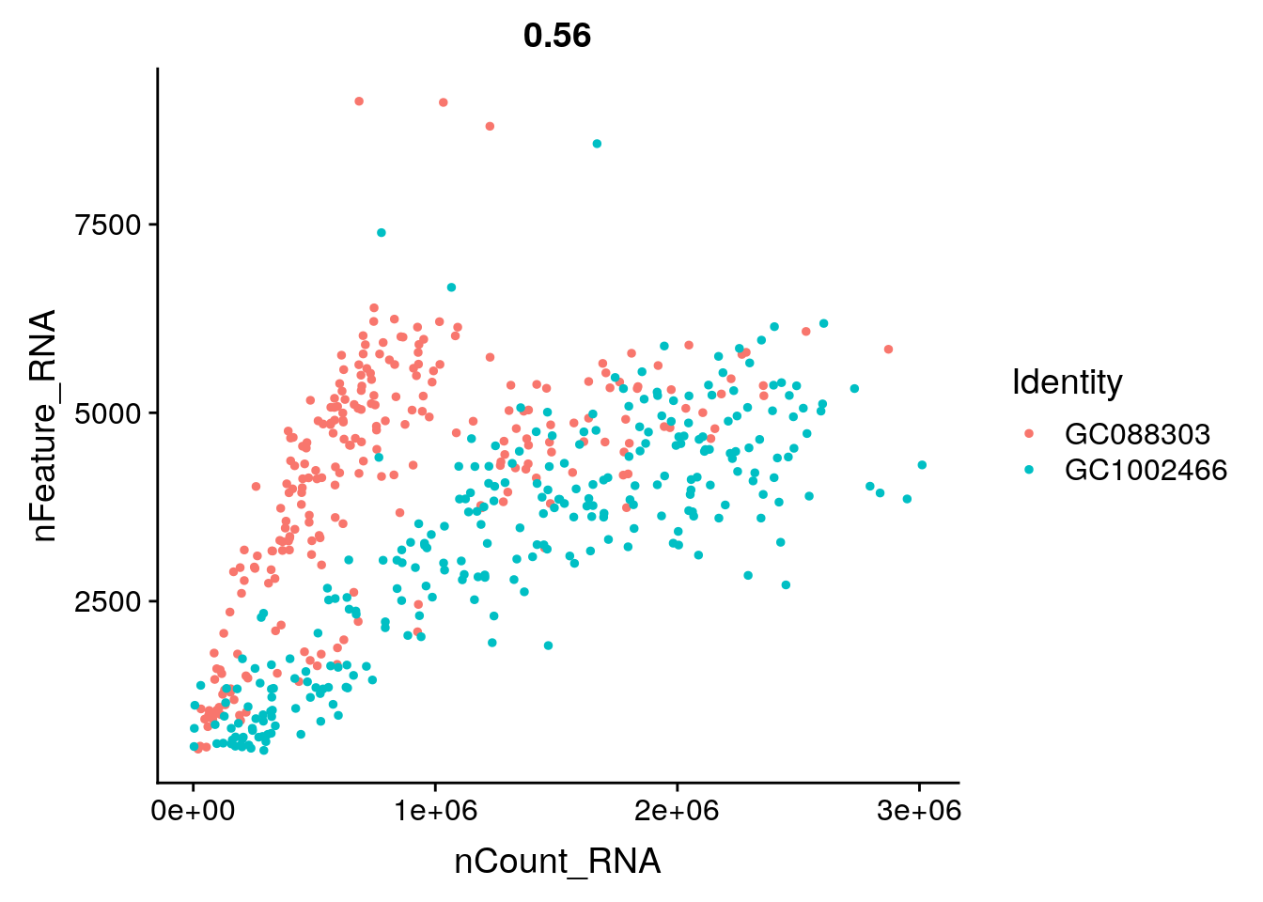
Single-cell RNA Data Analysis
Results Interpretation
A few GB of raw and analyzed data: Fastq, BAM, counts…
Report files: UMAPs, t-sne plots, differentially expressed genes, reads quality report, counting report,…

Slide 5
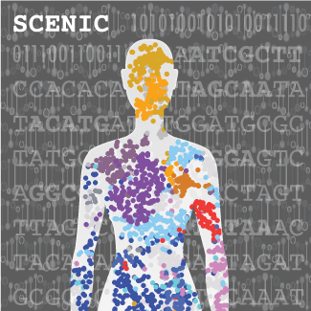
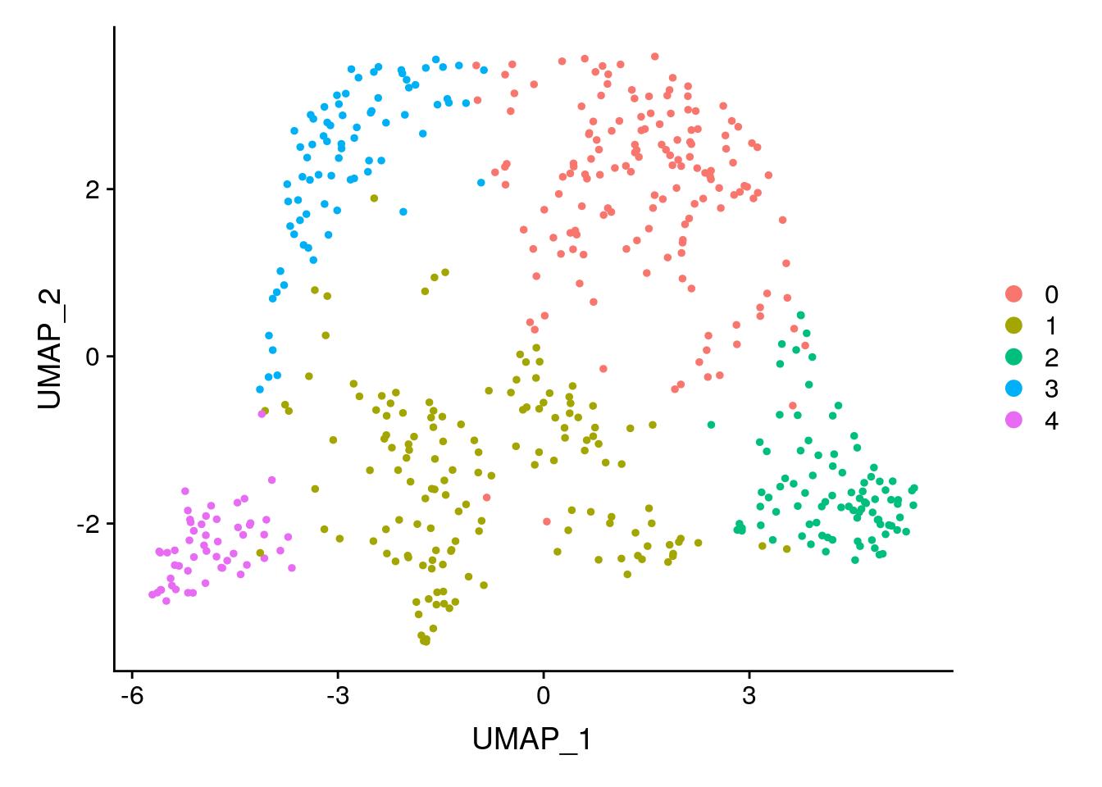
Downstream Analysis and Reanalysis
Reviewer: “The transcriptional and proteomic profiling experiments propose some interesting followup pathways for further analysis that may shed light on the mechanisms underlying these conditions. “
(*) https://aertslab.org/
Downstream analysis
Reanalysis

Slide 6
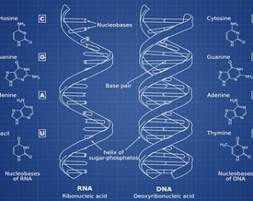
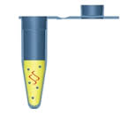
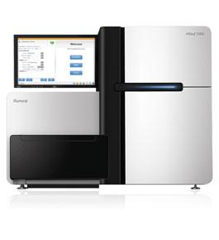

NGS Bioinformatics
Experimental Design
Sequencing
Downstream
Analysis
Library Preparation
Bioinformatics
Thursday
Thursday
Friday

Slide 7
(sc)NGS Sequencing Pipeline
Sequencing
Demultiplexing
Fastq(c)
Alignment
DNA
RNA
Variant Calling
Counting
SNV
CNV
Differential Expression
Cell Identification

Slide 8
From DNA molecules to digital reads
DNA Library
Reads

Slide 9
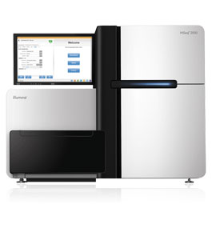

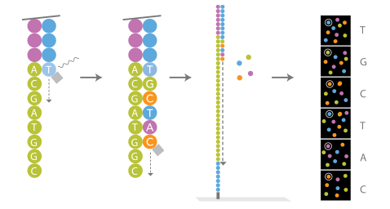

From (c)DNA Molecules to Digital Reads
Sequencer produces images that are converted to bases: base calling
Molecular Information becomes digital data

Slide 10
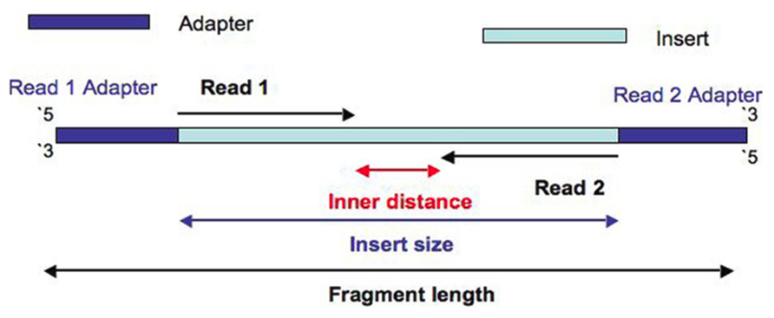
Reads and Fragments
Fragment: biological entity
Read: bioinformatic concept
Fragment: the DNA template + adapters that were loaded on the sequencing machine (is not completely sequenced)
Read: a raw sequence originating from a sequencing machine
Single Read: Sequencing only from one end
Paired-end: Sequencing starting from both ends of the insert

Slide 11
Demultiplexing
Sequencing
Demultiplexing
Fastq(c)
Alignment
DNA
RNA
Variant Calling
Counting
SNV
CNV
Differential Expression
Cell Identification

Slide 12
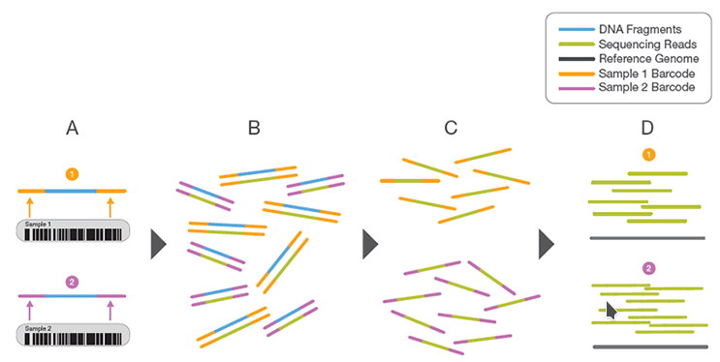
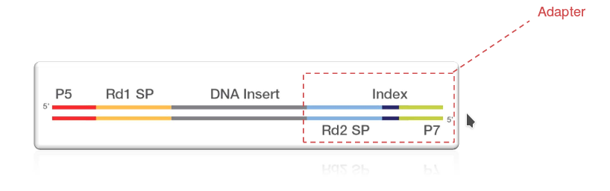
(De)Multiplexing
Multiple samples can be pooled together or multiplexed into one or more flowcells
Demultiplexing
Multiplexing
Identifier of the originating sample

Slide 13
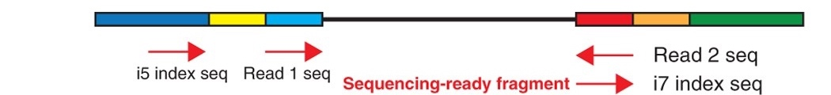

(De)Multiplexing Smart-Seq 2
Each sample *one* cell
Double index allows to pool more than 96 samples per sequencing lane
Each samples produces one (R1) or two (R1 and R2) fastq files
Usually single read, 51bp

Slide 14
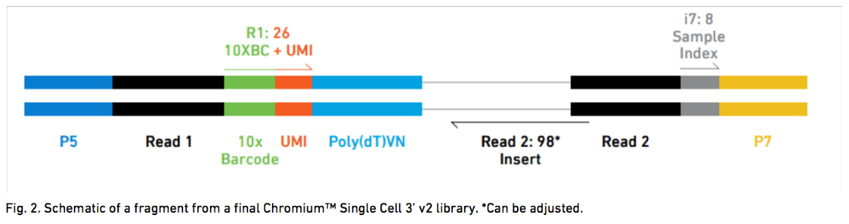
(De)Multiplexing 10x
Each sample *multiple* cells
Fragment contains information about the sample, the cell and the molecule
Always paired-end sequenced

Slide 15


(De)Multiplexing 10x
Index: Unique sample identifier
UMI: Unique Molecule identifier
10x Barcode: Unique cell identifier

Slide 16
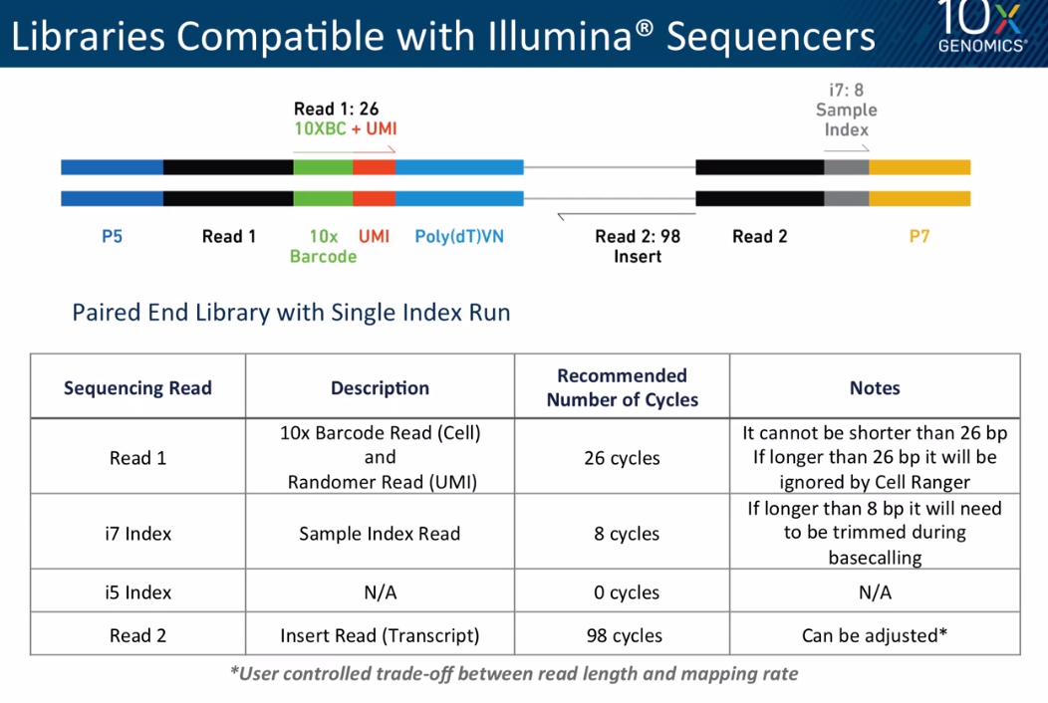
(De)Multiplexing 10x

Slide 17
Reads and Fastq Files
Sequencing
Demultiplexing
Fastq(c)
Alignment
DNA
RNA
Variant Calling
Counting
SNV
CNV
Differential Expression
Cell Identification

Slide 18
Fastq Format & Files
The result of demultiplexing is one (or two for paired-end reads, three for 10x) fastq files containing raw reads
Human readable (not binary) text files.
Referred as raw data.
Fastq files are the raw diamonds of any NGS bioinformatics project
Compressed and should be kept safe
Large files
Reads

Slide 19
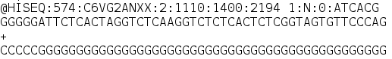
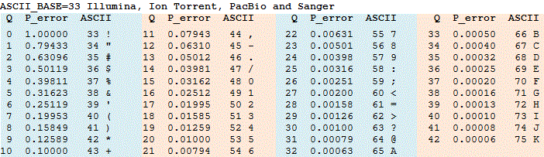
Raw Reads: Base Calling Quality
Probabilistic Database
A quality score (Q-score) is a prediction of the probability of an error in base calling.
It serves as a compact way to communicate very small error probabilities
P = 10^(–Q/10)
Q = –10 log10(P)
Base: G
Quality: C
ASCII: 67
Q: 34
P: 0.00040
Base: G
Quality: G
ASCII: 71
Q: 38
P: 0.00016

Slide 20
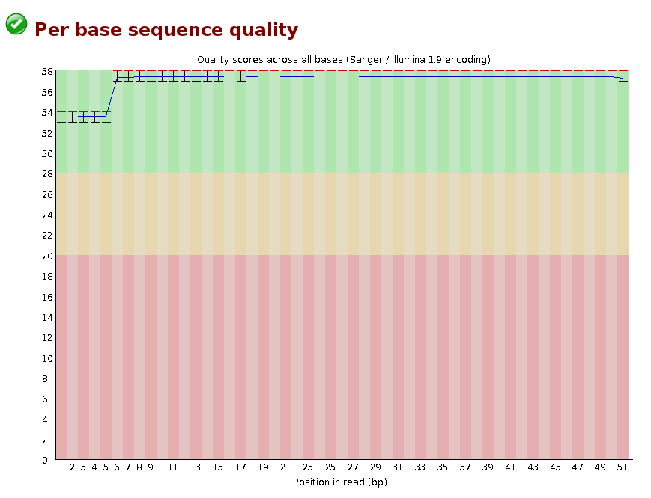
Is My Sequencing OK? FastQC Report

Slide 21
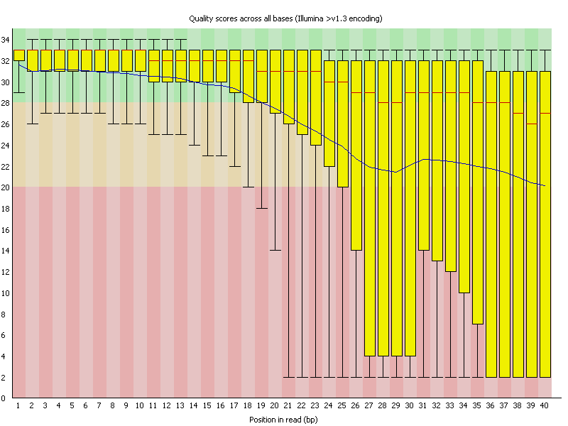
FastQC Report

Slide 22
Reads are:
Unordered
Incomplete
Redundant

Slide 23
Alignment (or Mapping)
Sequencing
Demultiplexing
Fastq(c)
Alignment
DNA
RNA
Variant Calling
Counting
SNV
CNV
Differential Expression
Cell Identification

Slide 24
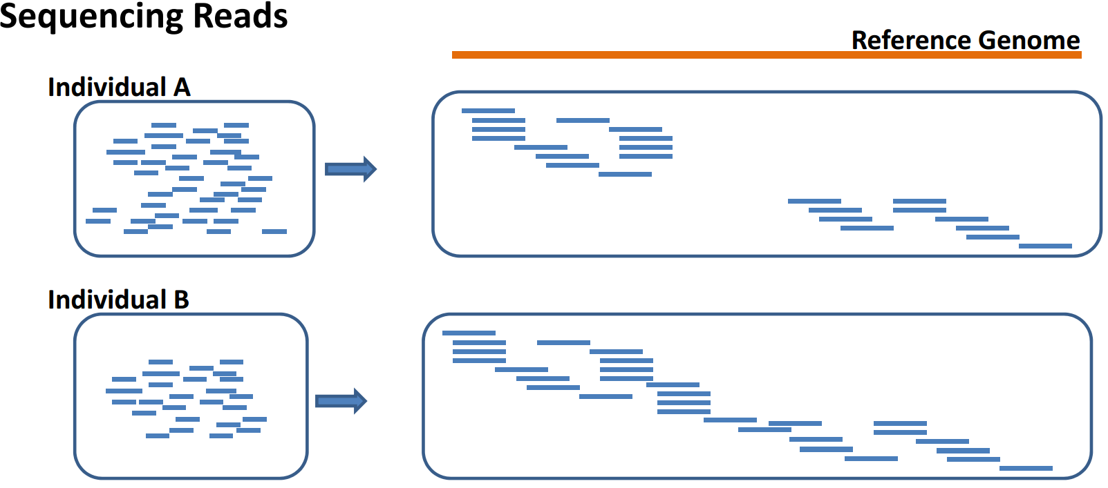
Mapping to Reference Genome
Mapping: Process of aligning reads to a reference sequence, whether the reference is a complete genome, transcriptome, or de novo assembly.
--http://sfg.stanford.edu/mapping.html
Identification of location in the genome the sequenced fragment arises from

Slide 25
scRNA-Seq Reads to Alignment
Reference genome
ScRNA-Seq reads
Alignment

Slide 26
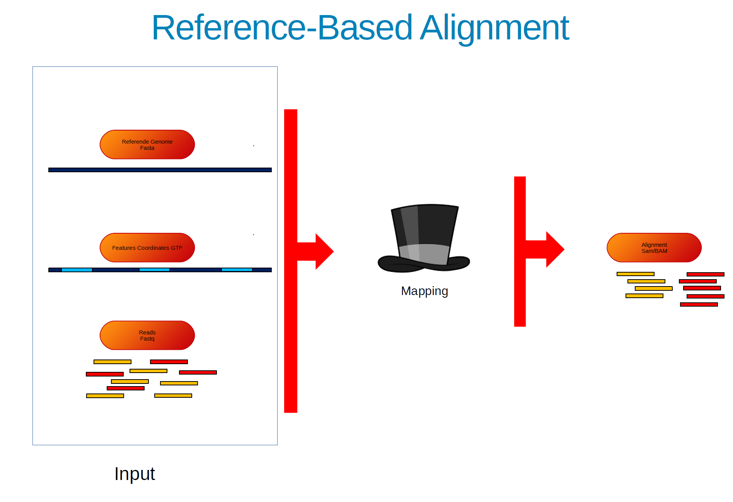

Slide 27
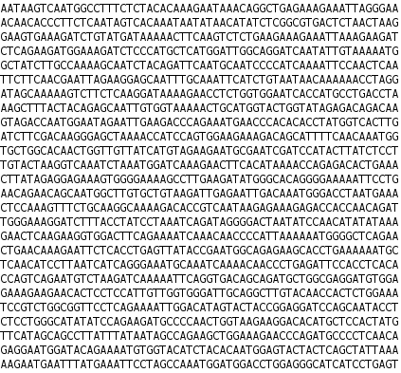
Reference Sequence in Fasta Format
Human-readable nucleotide sequence
Species dependent; human genome: ~3.000.000.000bp
Hg19, Hg38, Hg39

Slide 28


Splice-Aware Alignment
(sc)RNA-seq alignment differs from DNA alignment
If an RNA-Seq read spans an exon boundary, part of the map will not map contiguosly to the reference
This causes the standard mapping procedure to fail
E2
E3
E1
E2
E3
E4
E5
Gene
Splice aware mappers for scRNA-Seq: HISAT2, STAR, Cell Ranger (STAR)

Slide 29
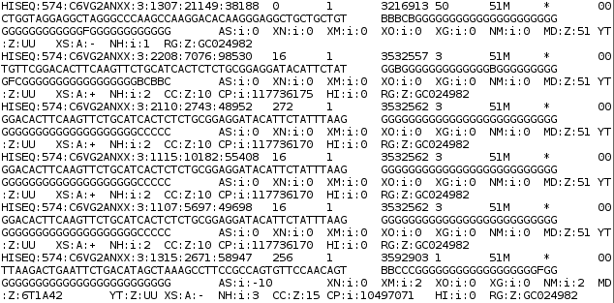
sc-RNA-Seq BAM/SAM
Extract SAM (Sequence Alignment Map) file
Reference Genome
BAM files are machine-readable versions of SAM files

Slide 30
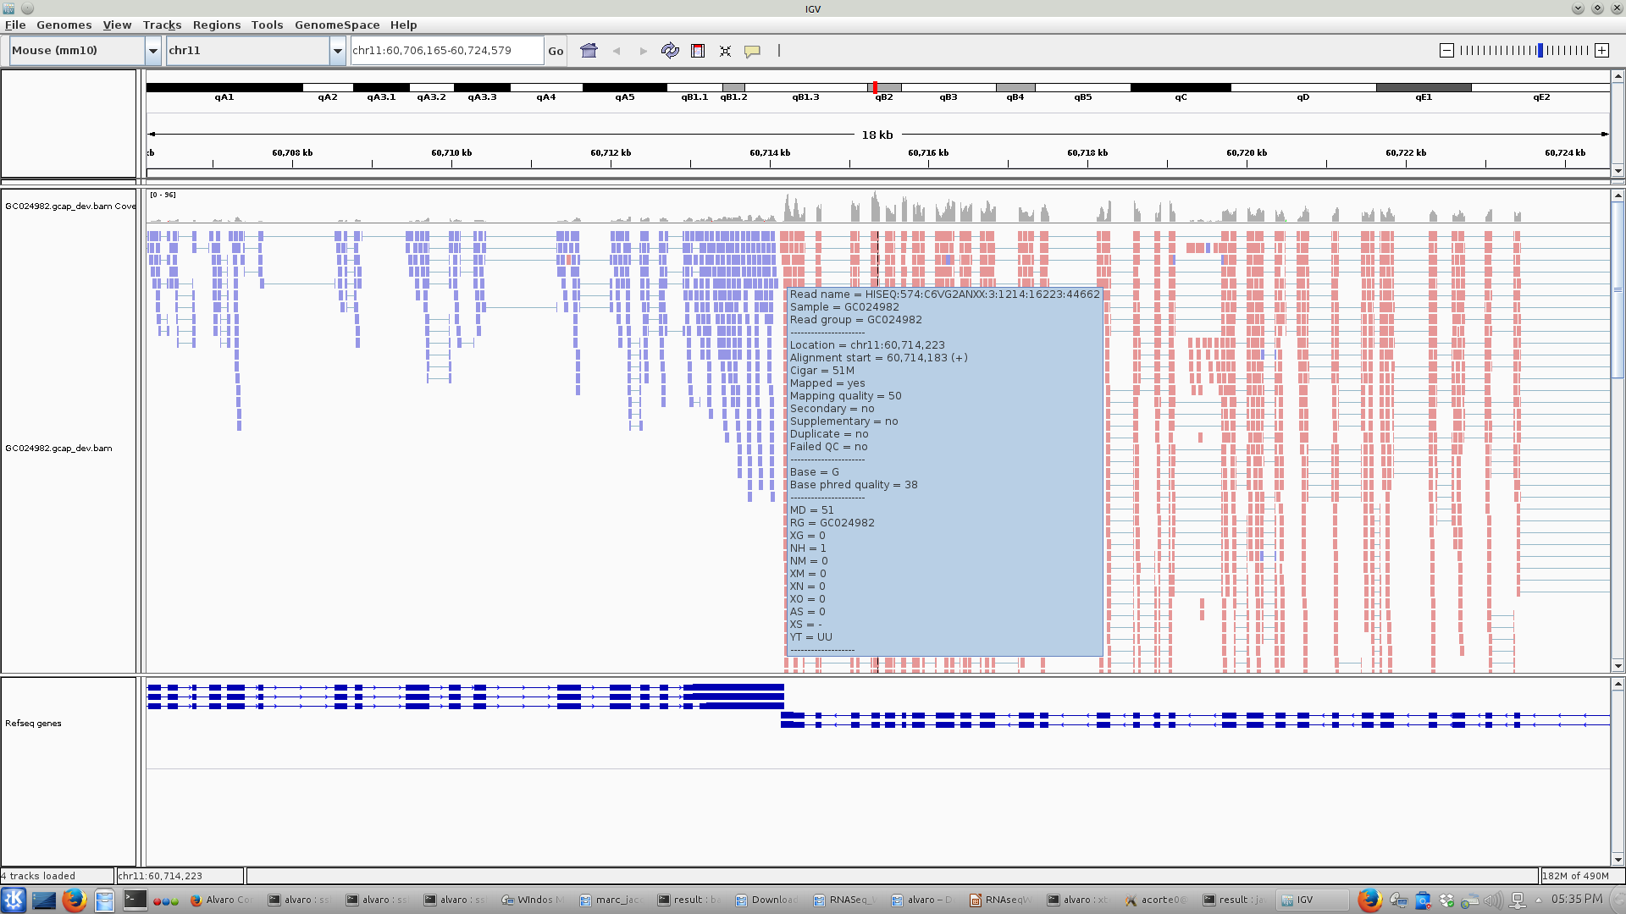
sc-RNA-Seq BAM/SAM: IGV

Slide 31
Gene Counting
Sequencing
Demultiplexing
Fastq(c)
Alignment
DNA
RNA
Variant Calling
Counting
SNV
CNV
Differential Expression
Cell Identification

Slide 32
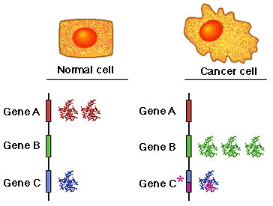
Sc-RNASeq Gene Expression
Sequencer produces millions of reads and a qualification for each base call
What reads have to do with differential expression of genes?
Read count is linearly related to the abundance of the target transcript

Slide 33
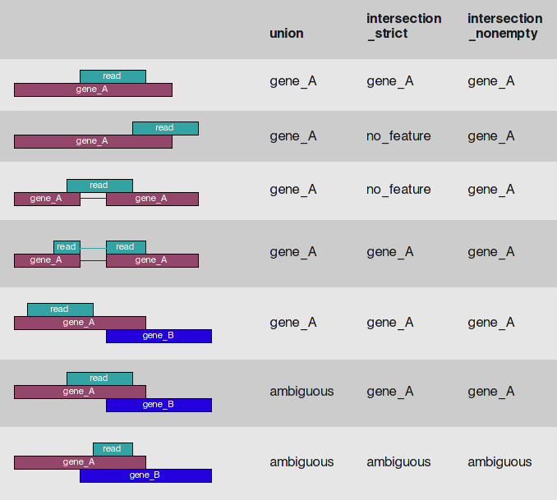
Counting Reads in HTSeq
Method:
Count each read only once
Multi-mapping reads and reads overlapping
multiple features discarded
1,2,3,4
1,2,3
Simon Anders

Slide 34
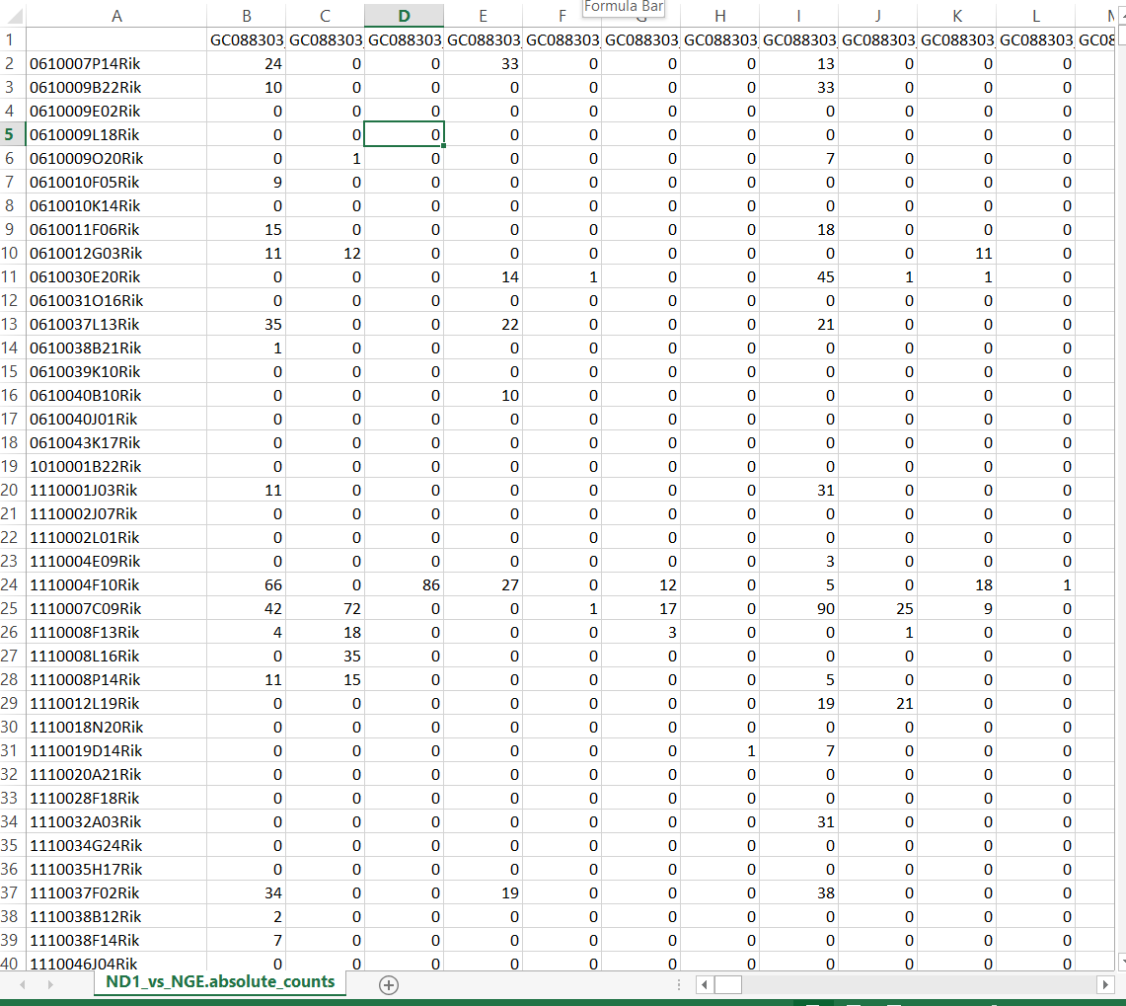
Absolute Counts Matrix
1,2,3,4
1,2,3
Input for sc-analysis packages Seurat and Scater: Next presentation

Slide 35
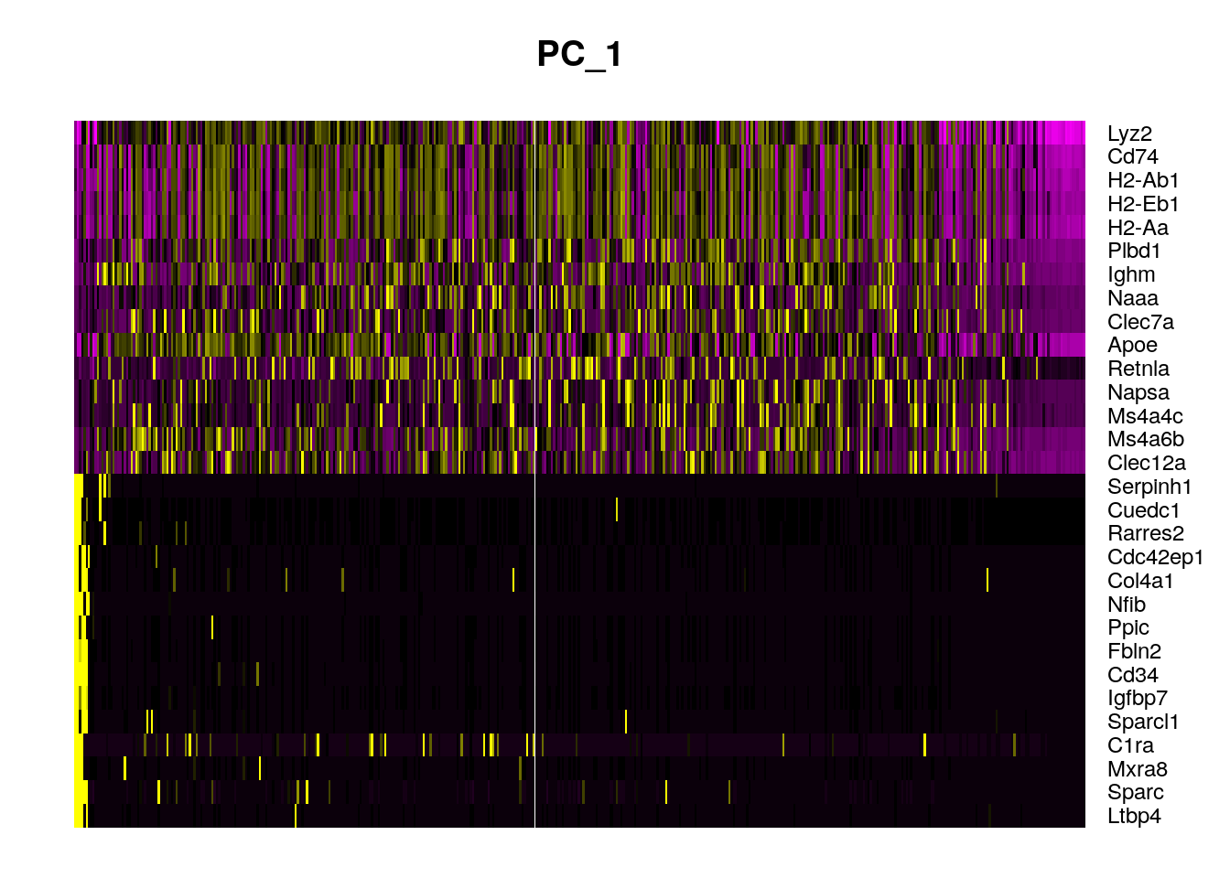
How do I start?
Depends on where you want to start:
Fastq files: always delivered by Genomics Core
Count Matrix:
10x: Cell ranger
Smart-Seq2: STAR, HTSeq
Analyzed data: Cluster/cell Identification, QC, DE

Slide 36
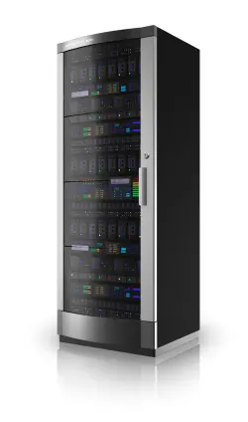
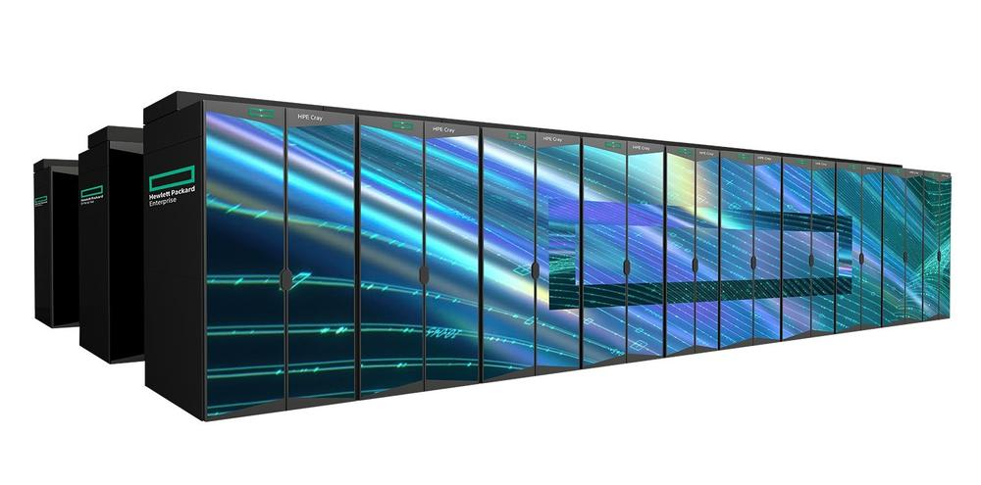

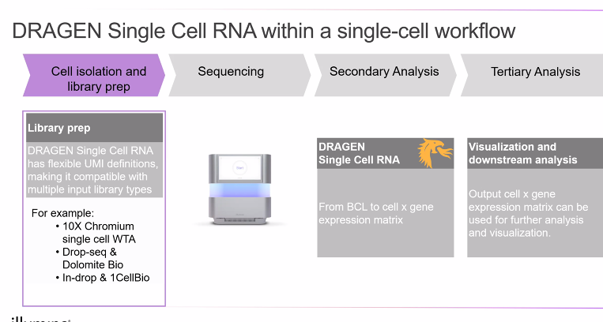

Computing Options
Flemish Super Computer
Google Cloud Genomics
Genomics Core
7416 Cores (Skylake/Cascade Lake)

Slide 37
Gene Counting
Sequencing
Demultiplexing
Fastq(c)
Alignment
DNA
RNA
Variant Calling
Counting
SNV
CNV
Differential Expression
Cell Identification
To be continued…

Slide 38


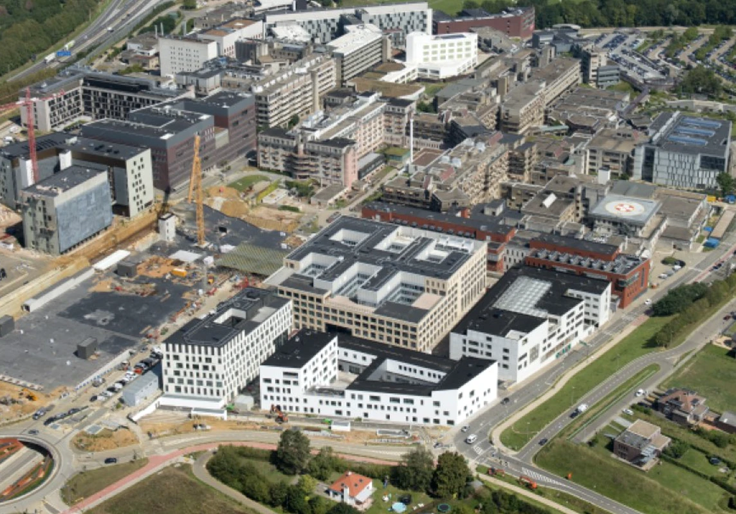
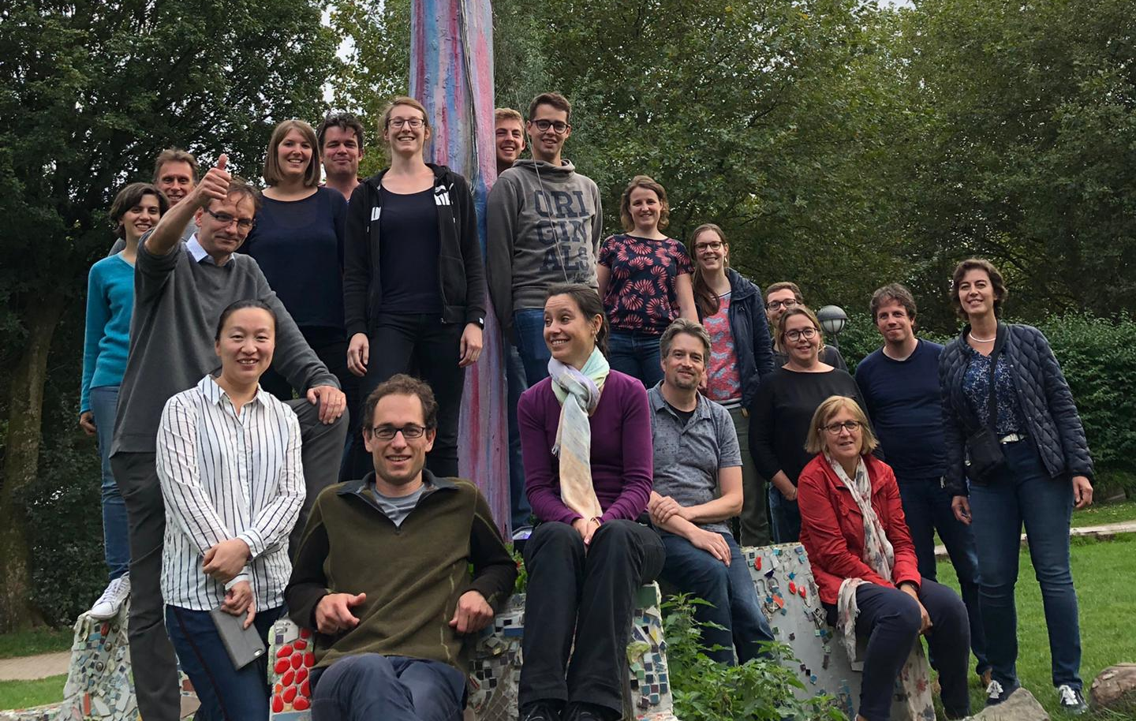
On behalf of the Genomics Core Leuven
Thank You!

